Slide 1
CPSC331 - Spring 2019 Tutorial 17
Khobaib Zaamout

Slide 2
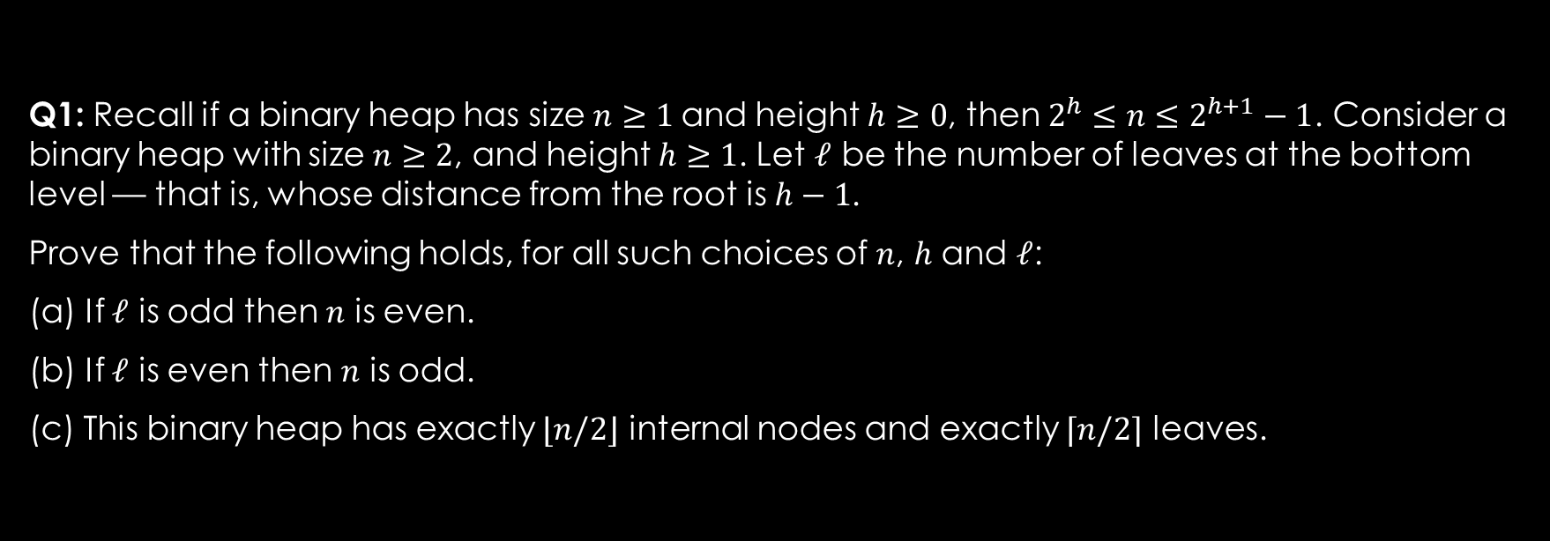
Q1: Prove that the following holds
Q1: Recall if a binary heap has size $n≥1$and height $h≥0$, then $2^{h}≤n≤2^{h+1}−1$. Consider a binary heap with size $n≥2$, and height $h≥1$. Let $ℓ$ be the number of leaves at the bottom level — that is, whose distance from the root is $h−1$.
Prove that the following holds, for all such choices of $n$, $h$ and $ℓ$:
(a) If $ℓ$ is odd then $n$ is even.
(b) If $ℓ$ is even then $n$ is odd.
(c) This binary heap has exactly $⌊n/2⌋$ internal nodes and exactly $⌈n/2⌉$ leaves.

Slide 3
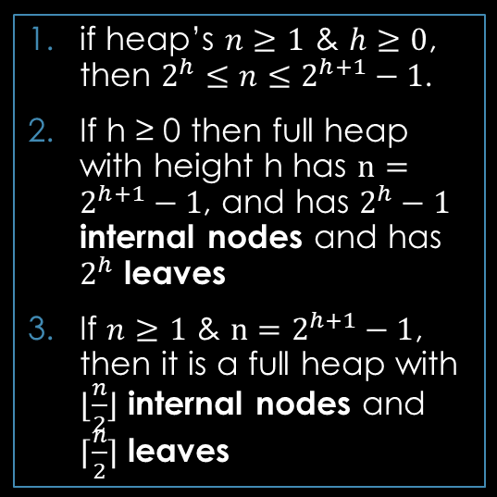
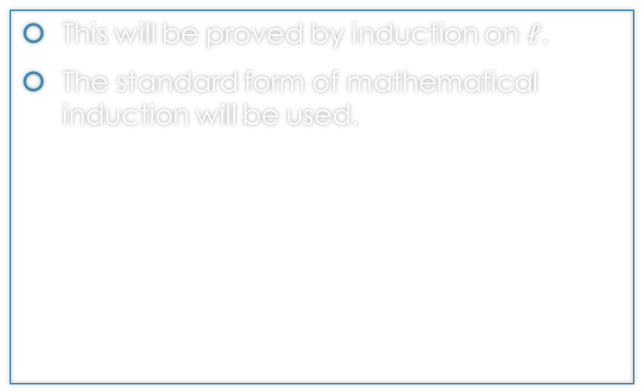
Q1: Prove that the following holds
Work Area:
Proof outline:
Facts:
This will be proved by induction on $ℓ$.
The standard form of mathematical induction will be used.
Basis
Inductive Step:
Inductive Hypothesis
Inductive Claim
Proof Steps
Proof Closure
if heap’s $n≥1$ & $h≥0$, then $2^{h}≤n≤2^{h+1}−1$.
If h ≥ 0 then full heap with height h has $n=2^{h+1}−1$, and has $2^{h}−1$ internal nodes and has $2^{h}$ leaves
If $n≥1$ & $n=2^{h+1}−1$, then it is a full heap with $⌊\frac{n}{2}⌋$ internal nodes and $⌈\frac{n}{2}⌉$ leaves

Slide 4
Q1: Prove that the following holds
Work Area: Basis
Proof outline:
Facts:
Basis
Inductive Step:
Inductive Hypothesis
Inductive Claim
Proof Steps
Proof Closure
if heap’s $n≥1$ & $h≥0$, then $2^{h}≤n≤2^{h+1}−1$.
If h ≥ 0 then full heap with height h has $n=2^{h+1}−1$, and has $2^{h}−1$ internal nodes and has $2^{h}$ leaves
If $n≥1$ & $n=2^{h+1}−1$, then it is a full heap with $⌊\frac{n}{2}⌋$ internal nodes and $⌈\frac{n}{2}⌉$ leaves

Slide 5

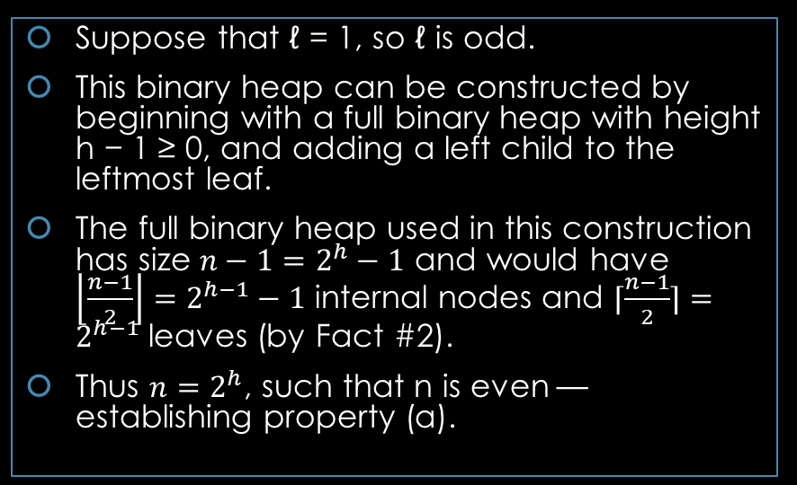
Q1: Prove that the following holds
Work Area: Basis
Proof outline:
Facts:
Suppose that ℓ = 1, so ℓ is odd.
This binary heap can be constructed by beginning with a full binary heap with height h − 1 ≥ 0, and adding a left child to the leftmost leaf.
The full binary heap used in this construction has size $n−1=2^{h}−1$ and would have $\left\lfloor \frac{n−1}{2}\right\rfloor =2^{h−1}−1$ internal nodes and $⌈\frac{n−1}{2}⌉=2^{h−1}$ leaves (by Fact #2).
Thus $n=2^{h}$, such that n is even — establishing property (a).
Basis
Inductive Step:
Inductive Hypothesis
Inductive Claim
Proof Steps
Proof Closure
if heap’s $n≥1$ & $h≥0$, then $2^{h}≤n≤2^{h+1}−1$.
If h ≥ 0 then full heap with height h has $n=2^{h+1}−1$, and has $2^{h}−1$ internal nodes and has $2^{h}$ leaves
If $n≥1$ & $n=2^{h+1}−1$, then it is a full heap with $⌊\frac{n}{2}⌋$ internal nodes and $⌈\frac{n}{2}⌉$ leaves

Slide 6
Q1: Prove that the following holds
Work Area: Basis
Proof outline:
Facts:
Since ℓ = 1, so ℓ is odd and therefore Property (b) holds.
Basis
Inductive Step:
Inductive Hypothesis
Inductive Claim
Proof Steps
Proof Closure
if heap’s $n≥1$ & $h≥0$, then $2^{h}≤n≤2^{h+1}−1$.
If h ≥ 0 then full heap with height h has $n=2^{h+1}−1$, and has $2^{h}−1$ internal nodes and has $2^{h}$ leaves
If $n≥1$ & $n=2^{h+1}−1$, then it is a full heap with $⌊\frac{n}{2}⌋$ internal nodes and $⌈\frac{n}{2}⌉$ leaves

Slide 7
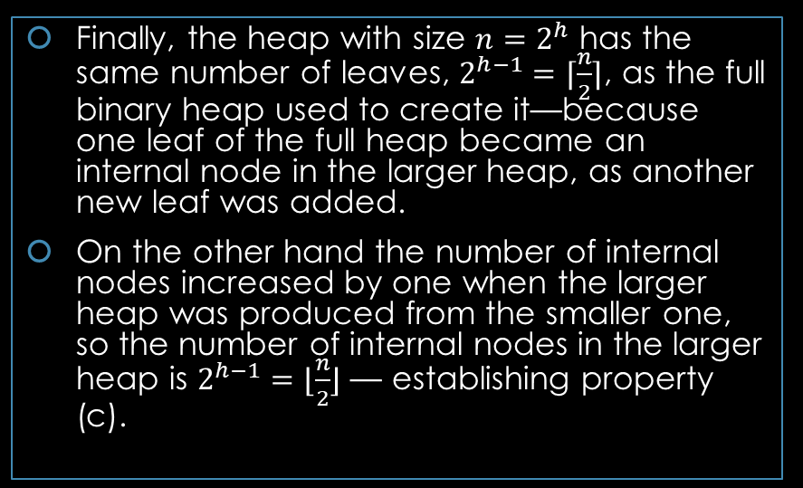
Q1: Prove that the following holds
Work Area: Basis
Proof outline:
Facts:
Finally, the heap with size $n=2^{h}$ has the same number of leaves, $2^{h−1}=⌈\frac{n}{2}⌉$, as the full binary heap used to create it—because one leaf of the full heap became an internal node in the larger heap, as another new leaf was added.
On the other hand the number of internal nodes increased by one when the larger heap was produced from the smaller one, so the number of internal nodes in the larger heap is $2^{h−1}=⌊\frac{n}{2}⌋$ — establishing property (c).
Basis
Inductive Step:
Inductive Hypothesis
Inductive Claim
Proof Steps
Proof Closure
if heap’s $n≥1$ & $h≥0$, then $2^{h}≤n≤2^{h+1}−1$.
If h ≥ 0 then full heap with height h has $n=2^{h+1}−1$, and has $2^{h}−1$ internal nodes and has $2^{h}$ leaves
If $n≥1$ & $n=2^{h+1}−1$, then it is a full heap with $⌊\frac{n}{2}⌋$ internal nodes and $⌈\frac{n}{2}⌉$ leaves

Slide 8
Q1: Prove that the following holds
Work Area: Inductive Step
Proof outline:
Facts:
Basis
Inductive Step:
Inductive Hypothesis
Inductive Claim
Proof Steps
Proof Closure
if heap’s $n≥1$ & $h≥0$, then $2^{h}≤n≤2^{h+1}−1$.
If h ≥ 0 then full heap with height h has $n=2^{h+1}−1$, and has $2^{h}−1$ internal nodes and has $2^{h}$ leaves
If $n≥1$ & $n=2^{h+1}−1$, then it is a full heap with $⌊\frac{n}{2}⌋$ internal nodes and $⌈\frac{n}{2}⌉$ leaves

Slide 9
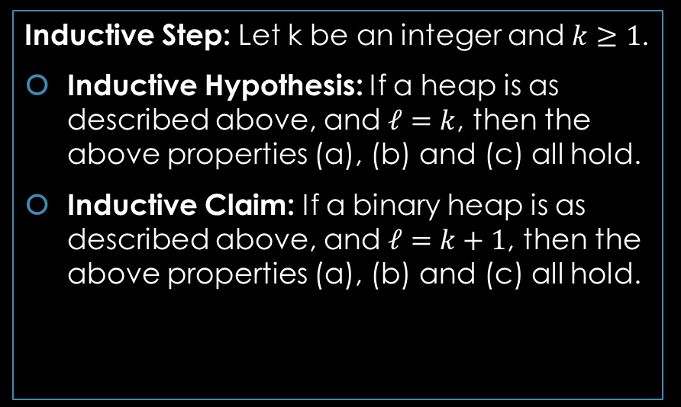
Q1: Prove that the following holds
Work Area: Inductive Step
Proof outline:
Facts:
Inductive Step: Let k be an integer and $k≥1$.
Inductive Hypothesis: If a heap is as described above, and $ℓ=k$, then the above properties (a), (b) and (c) all hold.
Inductive Claim: If a binary heap is as described above, and $ℓ=k+1$, then the above properties (a), (b) and (c) all hold.
Basis
Inductive Step:
Inductive Hypothesis
Inductive Claim
Proof Steps
Proof Closure
if heap’s $n≥1$ & $h≥0$, then $2^{h}≤n≤2^{h+1}−1$.
If h ≥ 0 then full heap with height h has $n=2^{h+1}−1$, and has $2^{h}−1$ internal nodes and has $2^{h}$ leaves
If $n≥1$ & $n=2^{h+1}−1$, then it is a full heap with $⌊\frac{n}{2}⌋$ internal nodes and $⌈\frac{n}{2}⌉$ leaves

Slide 10
Q1: Prove that the following holds
Work Area: Proof
Proof outline:
Facts:
Basis
Inductive Step:
Inductive Hypothesis
Inductive Claim
Proof Steps
Proof Closure
if heap’s $n≥1$ & $h≥0$, then $2^{h}≤n≤2^{h+1}−1$.
If h ≥ 0 then full heap with height h has $n=2^{h+1}−1$, and has $2^{h}−1$ internal nodes and has $2^{h}$ leaves
If $n≥1$ & $n=2^{h+1}−1$, then it is a full heap with $⌊\frac{n}{2}⌋$ internal nodes and $⌈\frac{n}{2}⌉$ leaves

Slide 11
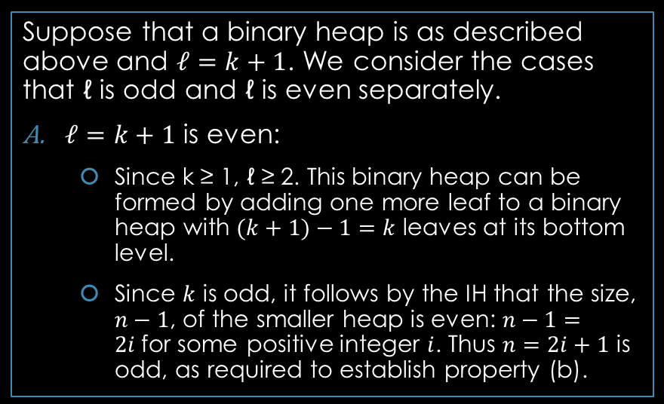
Q1: Prove that the following holds
Work Area: Proof
Proof outline:
Facts:
Suppose that a binary heap is as described above and $ℓ=k+1$. We consider the cases that ℓ is odd and ℓ is even separately.
$ℓ=k+1$ is even:
Since k ≥ 1, ℓ ≥ 2. This binary heap can be formed by adding one more leaf to a binary heap with $(k+1)−1=k$ leaves at its bottom level.
Since $k$ is odd, it follows by the IH that the size, $n−1$, of the smaller heap is even: $n−1=2i$for some positive integer $i$. Thus $n=2i+1$ is odd, as required to establish property (b).
Basis
Inductive Step:
Inductive Hypothesis
Inductive Claim
Proof Steps
Proof Closure
if heap’s $n≥1$ & $h≥0$, then $2^{h}≤n≤2^{h+1}−1$.
If h ≥ 0 then full heap with height h has $n=2^{h+1}−1$, and has $2^{h}−1$ internal nodes and has $2^{h}$ leaves
If $n≥1$ & $n=2^{h+1}−1$, then it is a full heap with $⌊\frac{n}{2}⌋$ internal nodes and $⌈\frac{n}{2}⌉$ leaves

Slide 12
Q1: Prove that the following holds
Work Area: Proof
Proof outline:
Facts:
Since ℓ is not odd, nothing needs to be done in order to establish property (a).
Basis
Inductive Step:
Inductive Hypothesis
Inductive Claim
Proof Steps
Proof Closure
if heap’s $n≥1$ & $h≥0$, then $2^{h}≤n≤2^{h+1}−1$.
If h ≥ 0 then full heap with height h has $n=2^{h+1}−1$, and has $2^{h}−1$ internal nodes and has $2^{h}$ leaves
If $n≥1$ & $n=2^{h+1}−1$, then it is a full heap with $⌊\frac{n}{2}⌋$ internal nodes and $⌈\frac{n}{2}⌉$ leaves

Slide 13
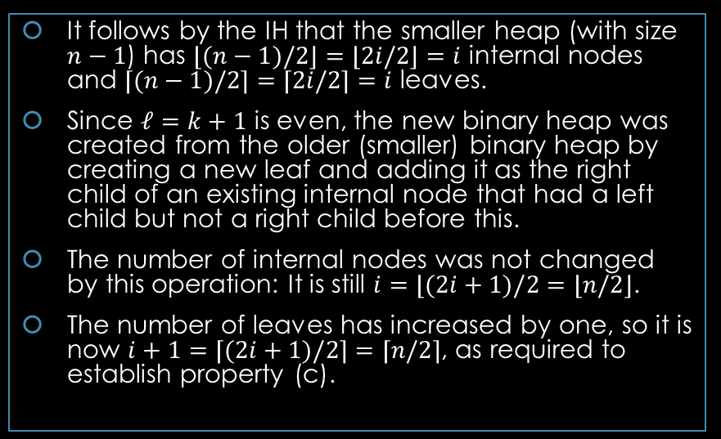
Q1: Prove that the following holds
Work Area: Proof
Proof outline:
Facts:
It follows by the IH that the smaller heap (with size $n−1$) has $⌊(n−1)/2⌋=⌊2i/2⌋=i$ internal nodes and $⌈(n−1)/2⌉=⌈2i/2⌉=i$ leaves.
Since $ℓ=k+1$ is even, the new binary heap was created from the older (smaller) binary heap by creating a new leaf and adding it as the right child of an existing internal node that had a left child but not a right child before this.
The number of internal nodes was not changed by this operation: It is still $i=⌊(2i+1)/2=⌊n/2⌋$.
The number of leaves has increased by one, so it is now $i+1=⌈(2i+1)/2⌉=⌈n/2⌉$, as required to establish property (c).
Basis
Inductive Step:
Inductive Hypothesis
Inductive Claim
Proof Steps
Proof Closure
if heap’s $n≥1$ & $h≥0$, then $2^{h}≤n≤2^{h+1}−1$.
If h ≥ 0 then full heap with height h has $n=2^{h+1}−1$, and has $2^{h}−1$ internal nodes and has $2^{h}$ leaves
If $n≥1$ & $n=2^{h+1}−1$, then it is a full heap with $⌊\frac{n}{2}⌋$ internal nodes and $⌈\frac{n}{2}⌉$ leaves

Slide 14
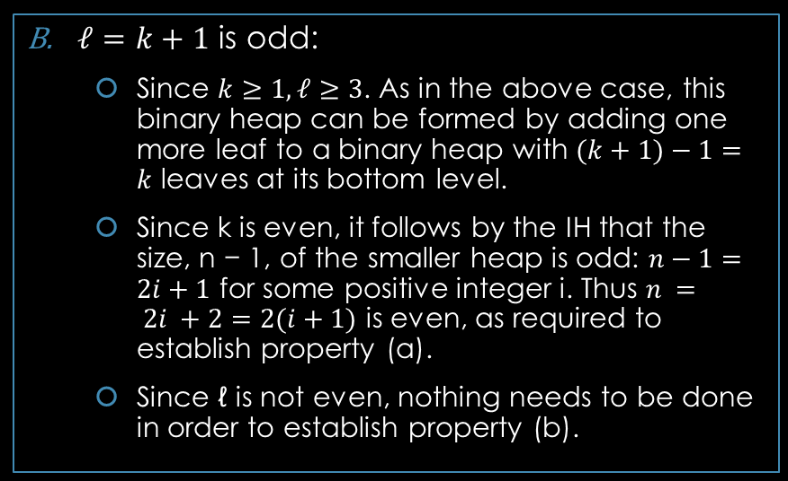
Q1: Prove that the following holds
Work Area: Proof
Proof outline:
Facts:
$ℓ=k+1$ is odd:
Since $k≥1, ℓ≥3$. As in the above case, this binary heap can be formed by adding one more leaf to a binary heap with $(k+1)−1=k$ leaves at its bottom level.
Since k is even, it follows by the IH that the size, n − 1, of the smaller heap is odd: $n−1=2i+1$ for some positive integer i. Thus $n = 2i +2=2(i+1)$ is even, as required to establish property (a).
Since ℓ is not even, nothing needs to be done in order to establish property (b).
Basis
Inductive Step:
Inductive Hypothesis
Inductive Claim
Proof Steps
Proof Closure
if heap’s $n≥1$ & $h≥0$, then $2^{h}≤n≤2^{h+1}−1$.
If h ≥ 0 then full heap with height h has $n=2^{h+1}−1$, and has $2^{h}−1$ internal nodes and has $2^{h}$ leaves
If $n≥1$ & $n=2^{h+1}−1$, then it is a full heap with $⌊\frac{n}{2}⌋$ internal nodes and $⌈\frac{n}{2}⌉$ leaves

Slide 15
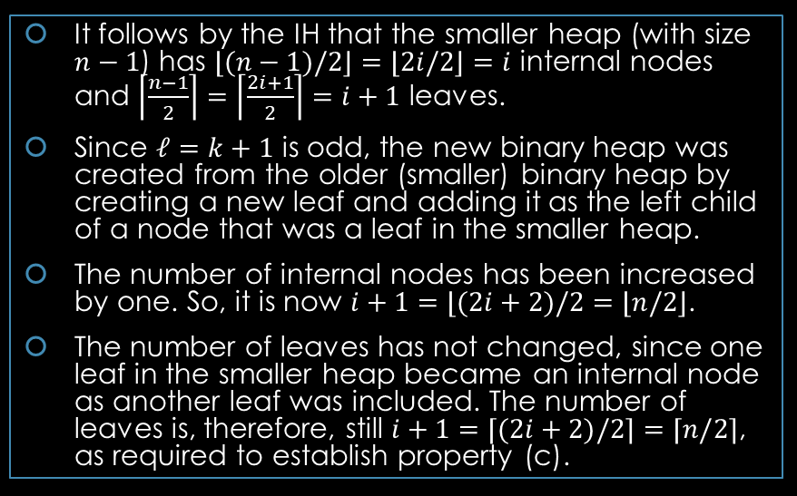
Q1: Prove that the following holds
Work Area: Proof
Proof outline:
Facts:
It follows by the IH that the smaller heap (with size $n−1$) has $⌊(n−1)/2⌋=⌊2i/2⌋=i$ internal nodes and $\left\lceil \frac{n−1}{2}\right\rceil =\left\lceil \frac{2i+1}{2}\right\rceil =i+1$ leaves.
Since $ℓ=k+1$ is odd, the new binary heap was created from the older (smaller) binary heap by creating a new leaf and adding it as the left child of a node that was a leaf in the smaller heap.
The number of internal nodes has been increased by one. So, it is now $i+1=⌊(2i+2)/2=⌊n/2⌋$.
The number of leaves has not changed, since one leaf in the smaller heap became an internal node as another leaf was included. The number of leaves is, therefore, still $i+1=⌈(2i+2)/2⌉=⌈n/2⌉$, as required to establish property (c).
Basis
Inductive Step:
Inductive Hypothesis
Inductive Claim
Proof Steps
Proof Closure
if heap’s $n≥1$ & $h≥0$, then $2^{h}≤n≤2^{h+1}−1$.
If h ≥ 0 then full heap with height h has $n=2^{h+1}−1$, and has $2^{h}−1$ internal nodes and has $2^{h}$ leaves
If $n≥1$ & $n=2^{h+1}−1$, then it is a full heap with $⌊\frac{n}{2}⌋$ internal nodes and $⌈\frac{n}{2}⌉$ leaves

Slide 16
Q1: Prove that the following holds
Work Area: Proof
Proof outline:
Facts:
This establishes the inductive claim in this case as well. Since the inductive claim has now been established in all cases, this completes the proof of the claim.
Basis
Inductive Step:
Inductive Hypothesis
Inductive Claim
Proof Steps
Proof Closure
if heap’s $n≥1$ & $h≥0$, then $2^{h}≤n≤2^{h+1}−1$.
If h ≥ 0 then full heap with height h has $n=2^{h+1}−1$, and has $2^{h}−1$ internal nodes and has $2^{h}$ leaves
If $n≥1$ & $n=2^{h+1}−1$, then it is a full heap with $⌊\frac{n}{2}⌋$ internal nodes and $⌈\frac{n}{2}⌉$ leaves

Slide 17
Q2: loop invariant
Q2: Confirm that the following is a loop invariant for the while loop in the heapify algorithm.
Loop Invariant:
a) An array (or ArrayList) A, storing values from ordered type T, has been given as input.
b) n is an integer variable whose value is the length of A.
c) i is an integer variable such that 0 ≤ i ≤ ⌊n/2⌋.
d) Consider the binary tree T represented by A — using the mapping from array locations to nodes used for a binary heap. For every integer j such that i ≤ j ≤ n, the subtree of T whose root corresponds to position j in A is a Maxheap.
Loop Invariant:
a) An array (or ArrayList) A, storing values from ordered type T, has been given as input.
b) n is an integer variable whose value is the length of A.
c) i is an integer variable such that 0 ≤ i ≤ ⌊n/2⌋.
d) For every integer j such that i ≤ j ≤ n, the subtree of T whose root corresponds to position j in A is a Maxheap.

Slide 18
Q2: loop invariant
Answer:
Consider an execution of this algorithm until the loop is reached:
Part (a): is implied by the precondition for the “Heapify” problem, and this is not changed before the while loop is reached.
Part (b): is satisfied when the while loop is first reached because the integer variable n is defined to have the length of A as its value when the step at line 1 is executed (and is not changed after that).
Part (c): is also satisfied when the loop is reached because the variable i is declared to be an integer and initialized with value ⌊n/2⌋ at line 2 at line 3.
Part (d): Finally, since i = ⌊n/2⌋ at this point, part (d) is a consequence of what has been noted above: For every integer j such that i = ⌊n/2⌋ ≤ j ≤ n − 1, the subtree, of the binary tree T represented by A, is a Maxheap because it has size one.
Thus the loop invariant is satisfied when the while loop is first reached.
Loop Invariant:
a) An array (or ArrayList) A, storing values from ordered type T, has been given as input.
b) n is an integer variable whose value is the length of A.
c) i is an integer variable such that 0 ≤ i ≤ ⌊n/2⌋.
d) For every integer j such that i ≤ j ≤ n, the subtree of T whose root corresponds to position j in A is a Maxheap.

Slide 19
Q2: loop invariant
Answer:
Consider an execution of the body of the loop:
Part (a): of the loop invariant simply describes the algorithm’s input, so it must also be true when this execution of the while loop ends.
Part (b): Neither the length of the input array A nor the value of the integer variable n when the body of the loop is executed, so part (b) is still true when this execution of the loop body ends because it was true when this execution of the loop body began.
Part (c): Since part (c) of the loop invariant was satisfied at the beginning of this execution of the loop body, i is an integer variable such that 0 ≤ i ≤ ⌊n/2⌋ — and, since the loop test at line 3 was checked and passed, i > 0, so that i ≥ 1. The value of i is not changed at line 4 but is decreased by one at line 5, so that 0 ≤ i ≤ ⌊n/2⌋−1 at the end of this execution of the loop body: Part (c) still holds at this point.
Part (d): Since part (d) of the loop invariant holds, the subtree whose root has index j was a Maxheap at the beginning of this execution of the loop body, for every integer j such that i ≤ j ≤ n − 1.
Loop Invariant:
a) An array (or ArrayList) A, storing values from ordered type T, has been given as input.
b) n is an integer variable whose value is the length of A.
c) i is an integer variable such that 0 ≤ i ≤ ⌊n/2⌋.
d) For every integer j such that i ≤ j ≤ n, the subtree of T whose root corresponds to position j in A is a Maxheap.

Slide 20
Q2: loop invariant
Part (d): Now consider any integer such that i − 1 ≤ j ≤ n − 1 after the application of the bubbleDown algorithm at line 4.
Let y be the node in the binary tree (represented by A) with index j:
If y is in the subtree whose root has index i−1 then it follows by the correctness of the bubbleDown algorithm that the subtree with root y is a Maxheap after this step — because the subtree with root has index i − 1 is now a Maxheap, and every subtree of a Maxheap is a Maxheap as well.
If y is not in the subtree whose root has index i − 1 then i ≤ j ≤ n − 1 and the subtree with root y has not been changed — so that it is a Maxheap after this step because it was a Maxheap before.
Thus the subtree whose root has index j is a Maxheap, after this step, for every integer j such that i − 1 ≤ j ≤ n − 1 after this step — and part (d) of the loop is still satisfied even after i is decremented, at line 5, and the bottom of the loop is reached.
Thus the loop invariant is also satisfied at the end of this execution of the loop body.
Loop Invariant:
a) An array (or ArrayList) A, storing values from ordered type T, has been given as input.
b) n is an integer variable whose value is the length of A.
c) i is an integer variable such that 0 ≤ i ≤ ⌊n/2⌋.
d) For every integer j such that i ≤ j ≤ n, the subtree of T whose root corresponds to position j in A is a Maxheap.

Slide 21
Q2: loop invariant
It now follows by “Loop Theorem #1” that the above loop invariant is correct, that is, it really is a loop invariant for the while loop in this algorithm.
Loop Invariant:
a) An array (or ArrayList) A, storing values from ordered type T, has been given as input.
b) n is an integer variable whose value is the length of A.
c) i is an integer variable such that 0 ≤ i ≤ ⌊n/2⌋.
d) For every integer j such that i ≤ j ≤ n, the subtree of T whose root corresponds to position j in A is a Maxheap.

Slide 22
Q3: Prove partial correctness
Q3: Use this to prove that the heapify algorithm is partially correct (when considered as an algorithm that solves the “Heapify” problem).

Slide 23
Q3: Prove partial correctness
Consider an execution of this algorithm that begins with the precondition for the “Heapify” problem satisfied, so that an array (or ArrayList) A, storing values of some ordered type T, has been given as input.
The while loop is eventually reached and executed.
If the execution never terminates at all then neither does the algorithm, as needed to establish “partial correctness” in this case.
On the other hand, if the execution of the loop terminates then the loop test must have
failed, so that i ≤ 0. However, it follows by part (c) of the loop invariant that i ≥ 0, so i = 0 when the execution of the loop, and the algorithm, ends.
Since the root of the binary tree represented by A corresponds to index 0, part (d) of the loop invariant (with j = i = 0) implies the postcondition for the “Heapify” problem, as needed to establish partial correctness in this case too.

